Slide 1

Marina Coast Water District
Reservation Road Desalination Plant Renovation Project
Phase 1
Pre-Bid Meeting and Field Walk
December 2, 2025

Slide 2
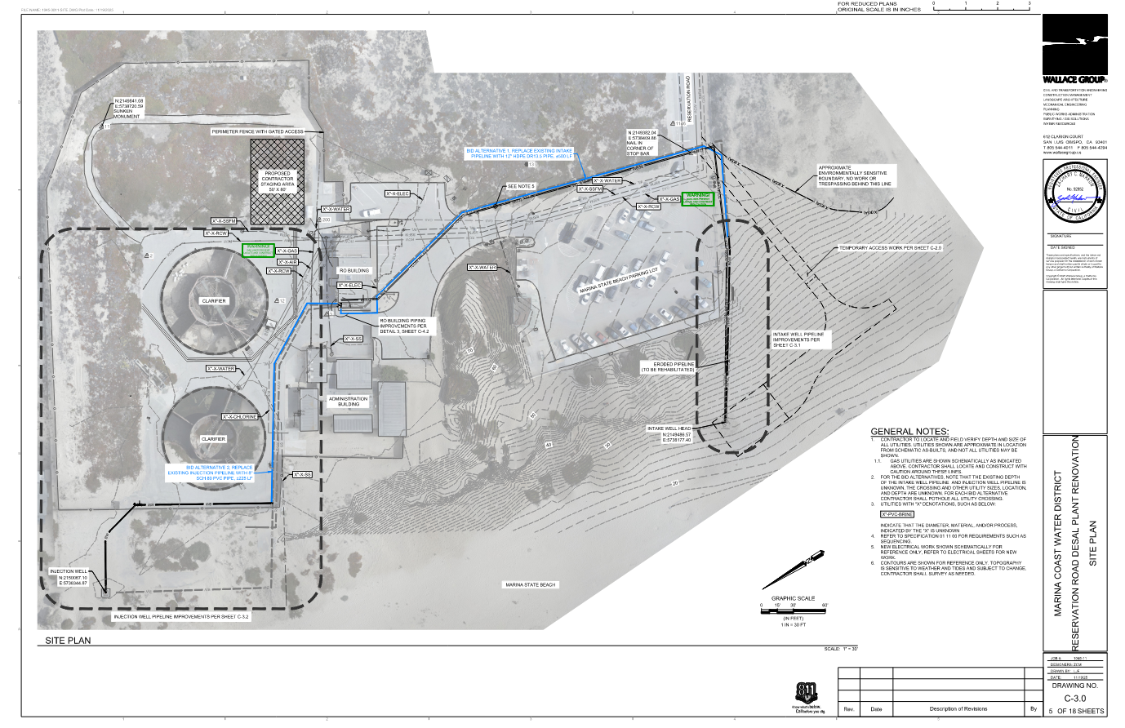
Project Overview
Project Scope (Spec. 01 11 00):
Pressure testing of existing piping
Intake Well Replacement:
Install replacement OFCI well pump.
Install replacement vault and piping.
Intake Piping Replacement:
Install 6” HDPE pipe and connect to existing 12” C900 pipe
Bid Alternate 1 for full replacement of existing intake supply pipe.
Desalination Plant Piping Replacement:
6” Schedule 80 PVC pipe, fittings, and flow meter.
Discharge Piping Replacement:
Install 8” Schedule 80 PVC pipe (below ground)
Install 8” SS piping (above ground)
Discharge wellhead replacement
Bid Alternate 2 for full replacement of existing intake supply pipe.
Replacement Electrical Systems:
OFCI switchgear, conduits/cabling, pull boxes, and level transducers
SHEET C-3.0

Slide 3
Bid Alternates
Alternate 1: Full replacement of existing intake well supply piping.
Approx. 450 LF of 12” DR 13.5 HDPE pipe and connection to desalination plant piping.
Alternate 2: Full replacement of existing brine discharge piping.
Approx. 225 LF of 8” Schedule 80 PVC pipe and connection to desalination plant piping.
Alternate 3: Rehabilitation of existing intake, discharge, and three (3) monitoring wells.
Removal of accumulated sediment/debris
Flushing/treatment of wells and zone pumping of screens.
Specific capacity tests on intake, discharge wells.
Handling and disposal of all sediment, debris, and test water.
Refer to Specification Section 01 11 00, Paragraph 1.1.B for full descriptions.
Refer to Specification Section 01 20 00 for measurement and payment procedures.

Slide 4
Project Coordination and Requirements
Agency Coordination (Spec 01 11 00, Para 1.1E)
Owner: Marina Coast Water District (MCWD)
City of Marina
State Agencies:
Department of Parks and Recreation (State Parks)
SWPPP/Environmental:
Owner submitted NOE; no mitigations at this time.
BMPs as identified in Plans and Specification Sections 01 57 13 and 01 57 23.
On-Site Storage/Staging Areas:
Contractor may use existing Desalination Plant facility for temporary storage/staging.
Permits (Spec 01 11 00, Para 1.9A)
City of Marina:
Encroachment Permit
State Department of Parks and Recreation:
Owner obtaining Right-of-Entry
Contractor to coordinate with Owner and State
Minimum 7 calendar days notice before entry
All costs for obtaining necessary permits shall be included in Bid Item No. 1 (Spec. 01 20 00)
Owner Furnished Equipment and Materials:
Replacement switchgear
Replacement intake well pump

Slide 5
Scheduling Requirements
Refer to Specification 01 11 00, Paragraph 1.9.B.
Sequencing details shall be included in Project Schedules and Construction Work Plan submittal.
First Item(s) of Work:
Pressure testing existing intake supply and brine discharge piping per Specifications.
Coordination with PG&E to de-energize existing switchgear.
Procurement of polymer concrete vault and other long-lead time items.
Well Access Plan submittal.
USA coordination and utility potholing.
Well rehabilitation shall be completed in the task order described in Section 33 01 10.91:
Monitoring Wells
Discharge Well
Intake Well
Well rehabilitation must be completed before installation of intake well pump, piping, and vault.
May require additional coordination with Owner’s Contractor if Bid Alternate 3 is not included in Contract.
OFCI switchgear shall be installed, tested, and operational prior to installation of intake well pump.

Slide 6
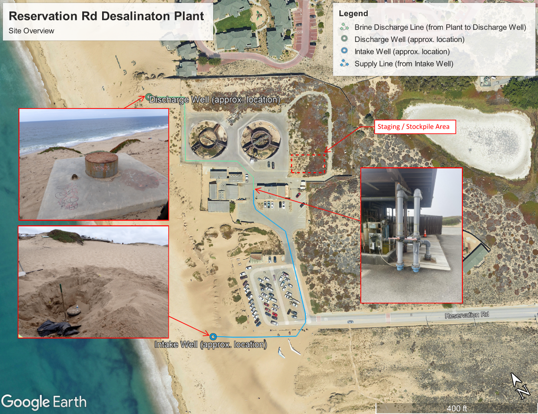
Site Overview

Slide 7
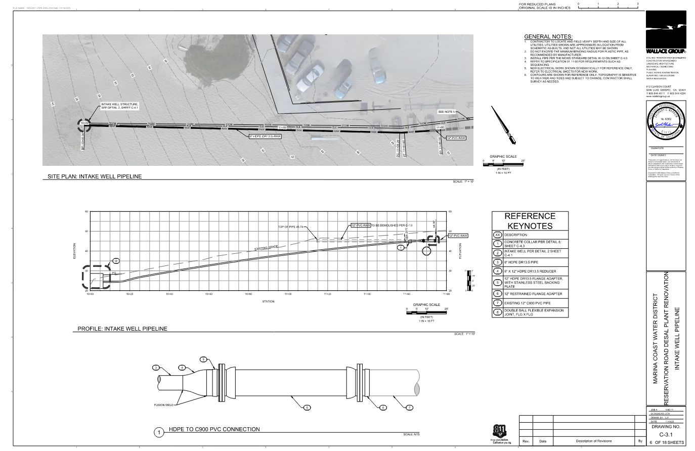
Intake Well Site Considerations
Well Access Plan
Section 31 00 01, Paragraph 1.03.A.2.
Min. 7 calendar days notice to Owner, State Parks prior to entry.
May use native materials for trench backfill for trench in State Beach property.
Handling of excess native dune sand material removed during trenching in State Beach Property.
Temporary stockpiling possible at existing Desalination Plant, as shown in Plans.
Avoid ex. electric, gas utilities in parking lot and Reservation Road.
Utilities are shown in approximate alignment based on record drawings. Contractor to pothole and verify.
Temporary cover must be installed on wellhead at end of each working day.
Sheet C-4.3, Detail 7
Install ESA fencing where shown and be aware of sensitive habitat signs. No work shall occur in sensitive habitat areas.
SHEET C-3.1

Slide 8
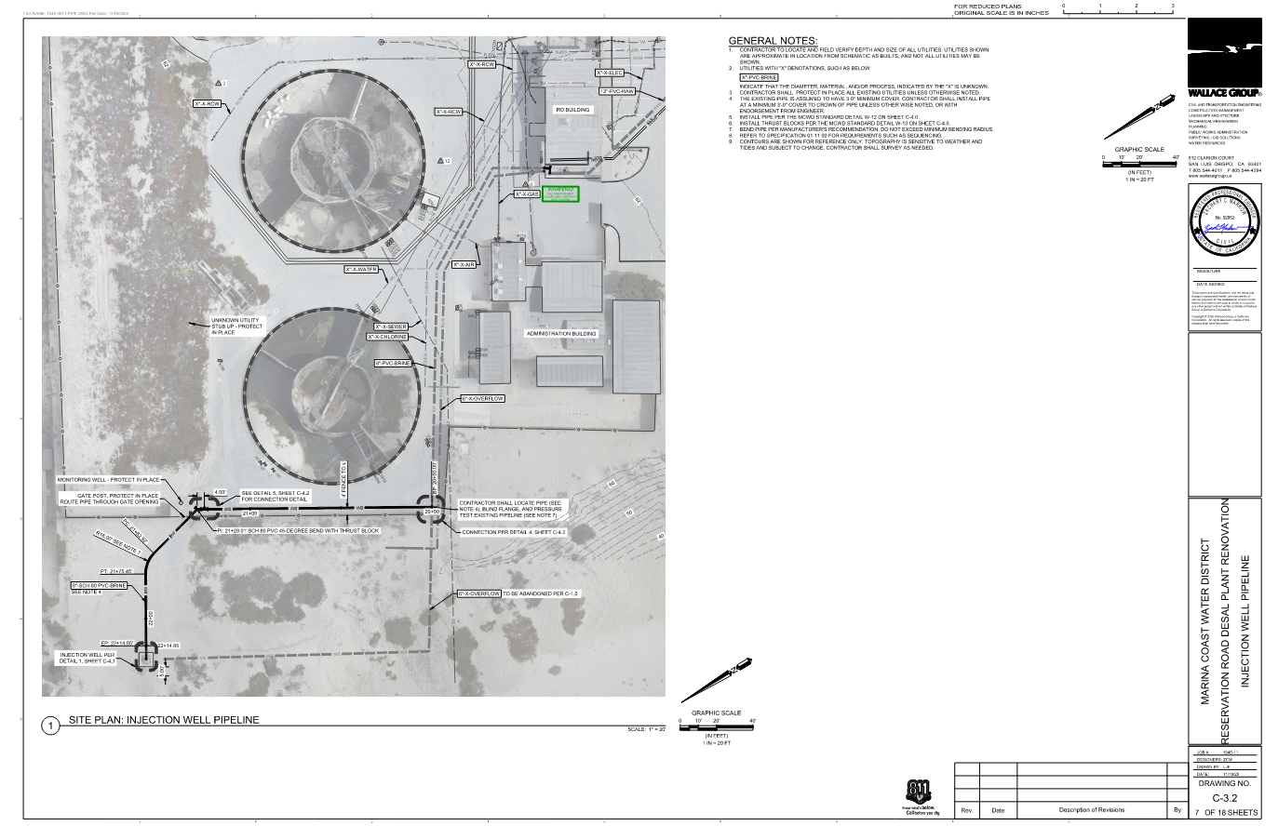
Discharge Well Site Considerations
Protect in place all existing groundwater monitoring wells.
Protect in place existing fencing/gates.
Coordinate access to facility with Owner.
May use native materials for trench backfill.
Fittings or alternate alignment may be considered instead of bend shown at STA 21+62.92 to STA 21+75.45.
Temporary stockpiling possible at existing Desalination Plant, as shown in Plans.
SHEET C-3.2

Slide 9
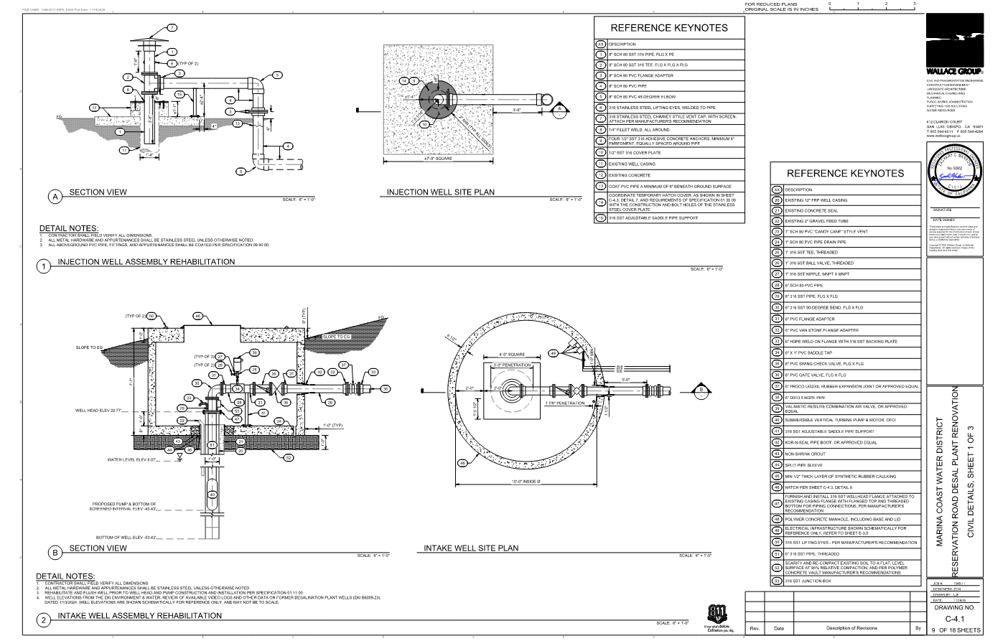
Well Rehabilitation Considerations
To be included in Construction Work Plan:
Locations for placement of all well rehabilitation equipment, including temporary storage tanks, piping, booster pumps, etc.
Refer to Specification Sections 01 11 00 and 33 01 10.91.
Equipment, labor, materials, and procedures utilized to properly dispose of all sediment, debris, and well development/test water discharged from wells during rehabilitation activities.
Abandoned clarifiers are available for discharge of well development and test waters.
Refer to Specification Section 33 01 10.91.
Public access to the Marina State Beach shall be preserved during all well rehabilitation efforts.
Public access points shall be coordinated with State Parks to minimize pedestrian and vehicular access to the Contractor’s work area(s).
SHEET C-4.1

Slide 10
Open Discussion / Q&A

